Slide 1
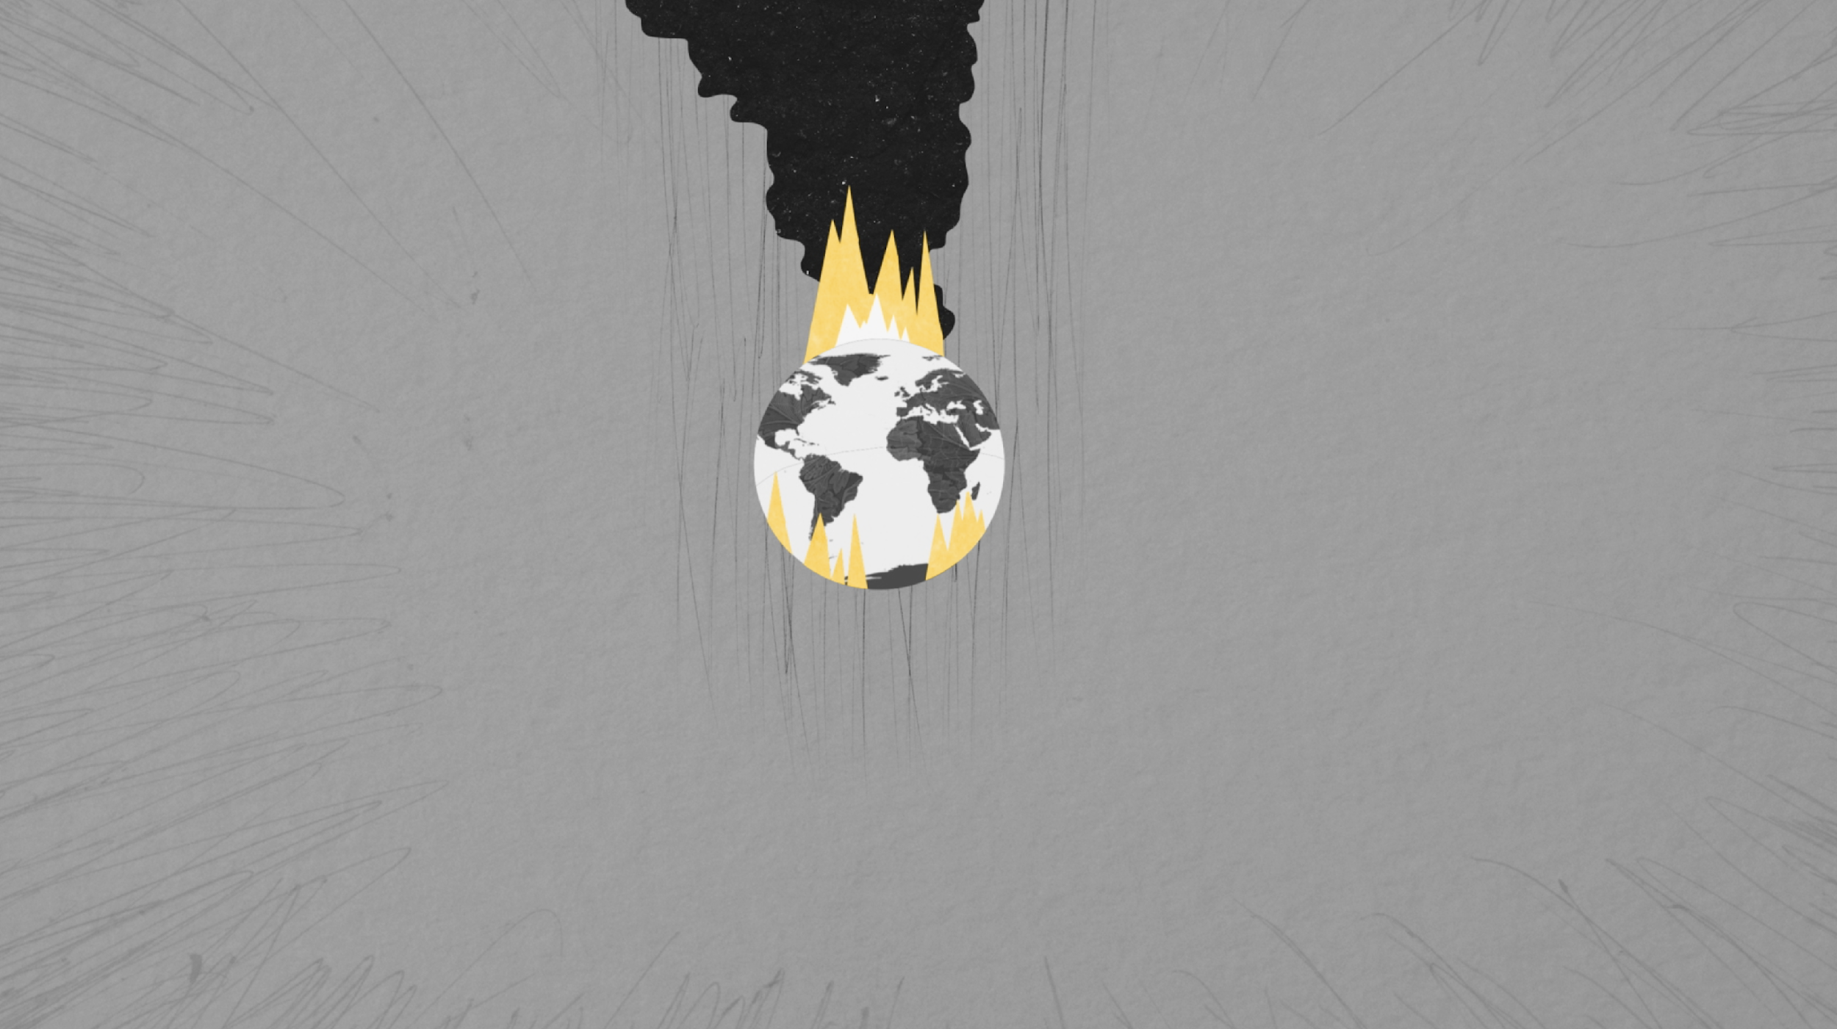
Navigating into the Future
Environment Committee Presentation

Slide 2
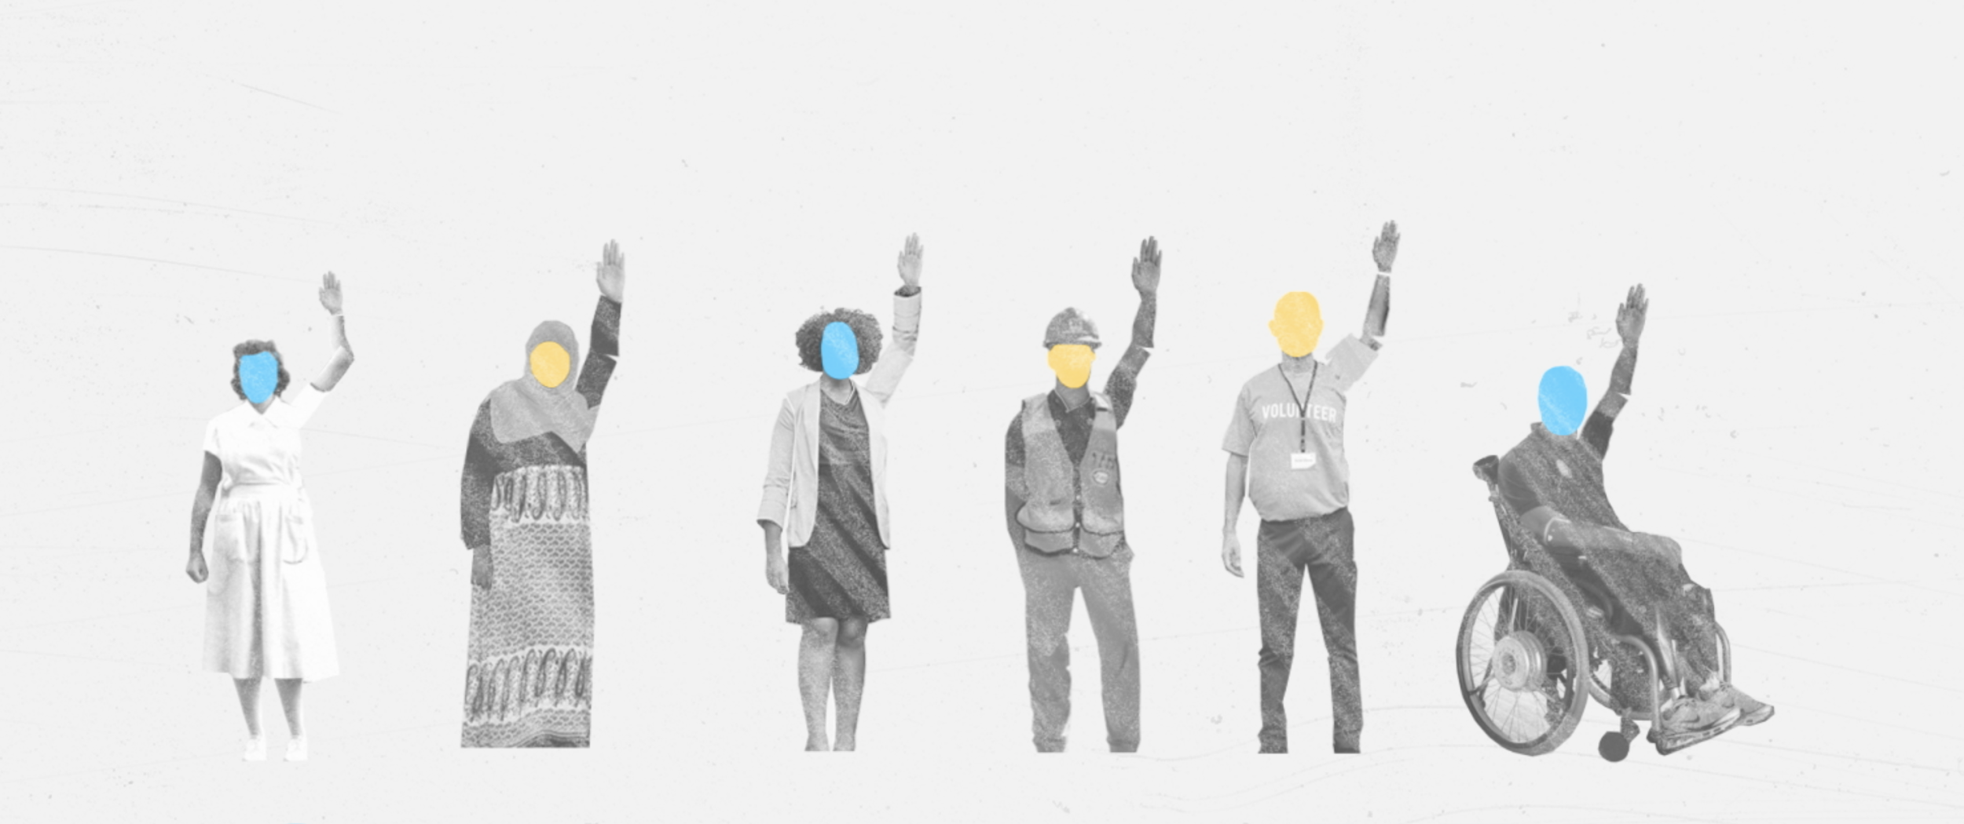
Objectives
What are the connections between climate change and the labour movement?
What is a Green New Deal and how can it help address the climate crisis?
How can AUPE get involved?
Notes:
Hello! We are the Environmental Committee from AUPE, and my name is [Christine Madigan] and my name is [Aaron Petty]. Thank you for giving us the opportunity to to speak with you about A Green New Deal for Alberta (also been called a “Just Transition”). The objectives of this presentation are to discuss how climate change is an important labour issue, discuss what a Green New Deal is and how it could help to address the climate crisis, and finally, to begin the discussion about what AUPE can do to support a Green New Deal for Alberta’s fossil fuel workers.

Slide 3
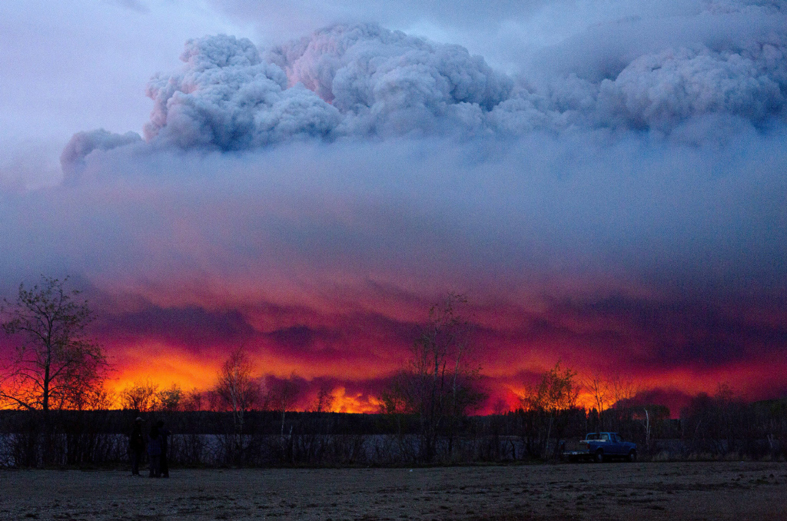
The Problems
Humans are changing the climate and the negative consequences are accelerating.
The inequality of our society is made worse by climate change, especially for those who are the most vulnerable.
Fort McMurray Wildfire, May 2016
Notes:
Your Environment Committee over the past four years or so, has been primarily concerned with the issue of climate change and has been thinking about ways that AUPE could contribute to the fight to protect our environment and our communities from the threat that climate change poses.
Worldwide, including in Alberta, we are facing a dual problem of Climate Change and Inequality. Each alone is bad enough, but together they each make the impacts of the other even worse. And then, to add insult to injury, both problems are continuously ignored and downplayed by inaction from our governments and the disinformation from the fossil fuel corporations, those most responsible for the mess we are in.
To summarize what we are facing:
●Climate Change is making the planet warmer - the 10 warmest years on record have occurred in the past decade or so.
○Earth has already warmed 1 degree above pre-industrial levels and is on track to hit 1.5 degrees above pre-industrial levels by 2030, which will have a catastrophic impact on our environment and on human survival.
○Humans are causing this warming by burning fossil fuels and releasing greenhouse gas emissions.
■Even if humans stopped emitting more greenhouse gasses tomorrow, the emissions already in the atmosphere will continue to cause the Earth to warm.
■But the longer we delay action the worse it will be; climate change is bad but every fraction of a degree warmer makes things exponentially worse.
○The consequences of climate change are dire, and the impacts of these disasters is most deeply felt for those who are the most vulnerable.
●Our society is deeply unequal, and this inequality continues to grow.
○The most vulnerable in our society are having poorer health, more difficulty accessing quality education, and shorter life spans. These outcomes are only worsened by climate change.

Slide 4
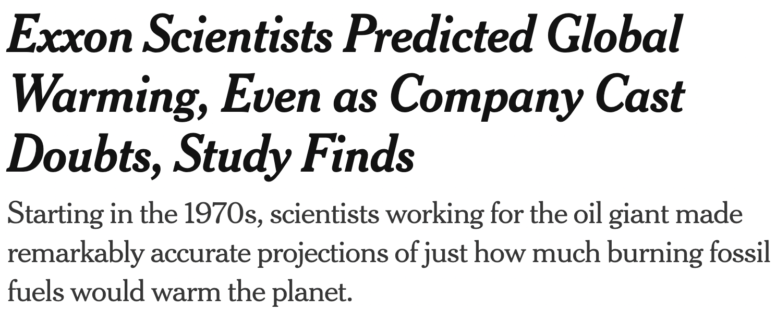
The Problems
We are putting more earth-warming gases into the atmosphere every year
Most governments, corporations, and employers are not taking action fast enough or on the scale required to avoid a catastrophe.
Kyoto Protocol
Scientists warn US President Lyndon Johnson about global warming
Covid pandemic
Global financial crisis
Svante Arrhenius writes first paper on CO₂’s effect on Earth temperature
Oil Crisis
New York Times Jan 12, 2023
Data source: ourworldindata.org
Notes:
We are putting more earth-warming gasses into the atmosphere every year and governments and corporations have failed to adequately address climate change or growing inequality. Even when politicians talk about transitioning away from fossil fuels, the policies they implement are simply not good enough to stop catastrophic levels of warming.
Time is short and burying our head in the sand will not make things better. Alberta needs its political leaders to give us a plan that can inspire us and give us hope for the future. We are at a crucial moment in history and we desperately need those in power to have the vision to lead us into a more just and equal society.

Slide 5
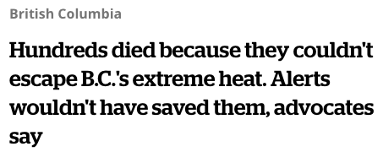
The Problems
California Storms Have Farmers Rushing to Avoid Crop Shortfall
Storms estimated to cause more than 1 Billion in farm damages.
Reduced crop supply expected to push US produce higher Bloomberg Jan.27, 2023
Natural disasters such as fires, floods, and drought are already increasing
Food is harder to grow and ship, making it more expensive and contributing to inflation
This inflation will quickly overtake the cost to build the Just Transition
Global News Oct 26, 2022
Why US vegetable prices have skyrocketed in the past year
Climate change-induced storms and drought have damaged crop yields across the western states.
CBC News June 7, 2022
Notes:
Did you know that as the climate warms our glaciers shrink? Our glaciers are a natural reservoir that store water over the spring and summer and as they melt they fill our rivers and lakes, which provide water to our farms and ranches.
This is just one example of the many ways climate change impacts all aspects of our lives. The more we delay the worse it will get. The cost of climate change will be borne in increased food prices, recovering from natural disasters and poorer health.

Slide 6
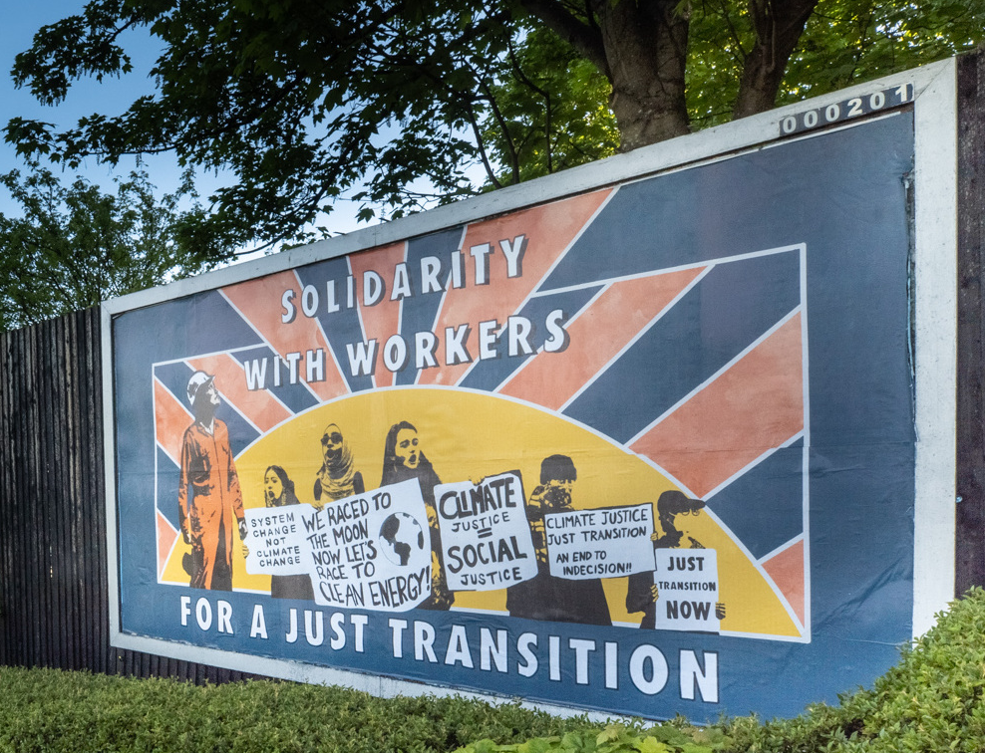
The Solution
We need a bold and ambitious vision at the scale and scope required to address the climate crisis.
This vision can help us to address inequality and help build the kind of society that protects and cares for the most vulnerable.
We can draw inspiration from the labour movement of the 1930’s that ultimately led to the New Deal.
Artist: Anarchxart
Notes:
The problems of climate change and inequality can feel overwhelming. That is why we need a bold and ambitious vision at the scale and scope required to address the climate crisis.
○This vision can help us build the kind of society that we want. One that protects the environment as well as those who are the most vulnerable.
●To address the dual problems of inequality and climate change, we can look to labour history for inspiration.
○In response to the Great Depression workers fought back - they organized new unions and the labour movement roared back to life.
○This movement ultimately lead to the creation of the New Deal.
■The New Deal was a massive infrastructure and job creation plan - it built roads, bridges, and national parks.
●Whether we like it or not, our economy in Alberta needs to move away from fossil fuels. If we want to be in control of our future, we should have a plan for a Green New Deal that both ensures workers are protected and that our society is better off.

Slide 7
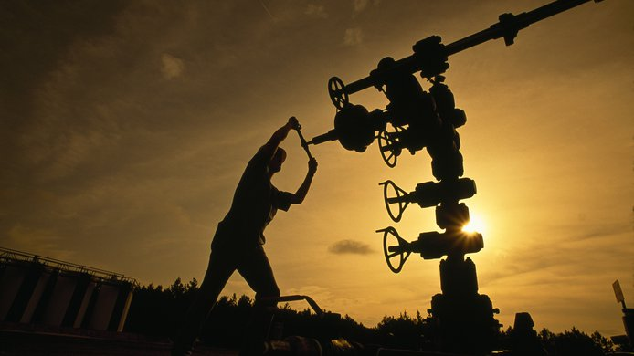
What about the fossil fuel sector?
Fossil fuel workers have made an important contribution to our province.
We have to dramatically reduce our consumption of fossil fuels if we are going to prevent climate disaster.
Fossil fuel workers deserve to be supported through our shift away from fossil fuels and towards renewable energy sources.
Notes:
●Alberta’s fossil fuel industry has greatly contributed to Alberta’s economy and our society as a whole. We live in a prosperous province in part because of hard working Albertans in the oil and gas industry.
●But the evidence is clear that we can’t continue as we have been without catastrophic consequences to our planet and our communities.
●Unfortunately, we are rapidly approaching a tipping point where we will be forced to transition away from fossil fuels either with a plan in place to protect those workers or without a plan at all.
○Fossil fuel companies are already making commitments to discontinue their investments in Alberta’s oil and gas industry. While Alberta is restricting the development of renewable energy, companies such as Shell are expanding investments in renewables.
●The Environment Committee understands that fossil fuel workers are not some abstract concept. They are our friends, our neighbors, our spouses, our children, our families. They are real people who deserve to have their hard work not only recognized but valued by our society. They deserve to be supported through a just transition away from fossil fuels

Slide 8
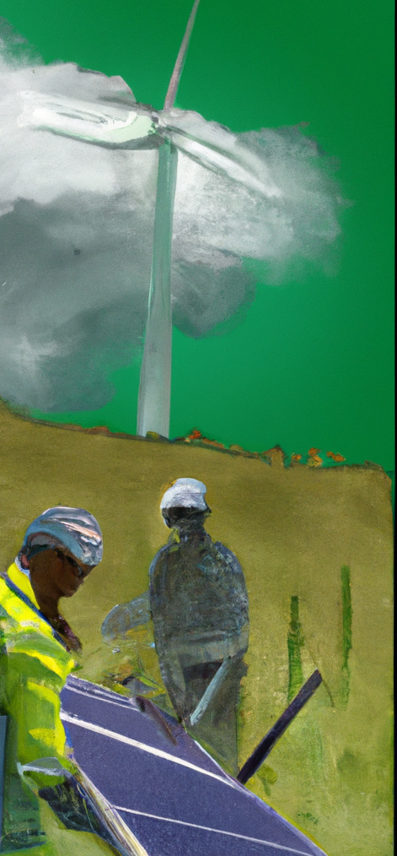
What is a Just Transition (or a Green New Deal)?
Refers to efforts to consider and prioritize the wellbeing of workers in the implementation of policies to reduce greenhouse gas emissions.
In a Just Transition, workers and communities have the power and the opportunity to participate in any decisions that are made about them and their futures.
Must create opportunities for workers, not just the end of an industry.
Notes:
●What is a Just Transition? Also called a Green New Deal
○A Just Transition means considering and prioritizing the wellbeing of workers in the implementation of policies to reduce greenhouse gas emissions.
○A number of political parties have tried to demonize the term Just Transition. But the idea of a Just Transition has been around for a long time.
○In practice, a Just Transition could look like a lot of different policies and programs. Such as, funding for retraining fossil fuel workers to pursue work in new fields, providing pensions to allow older workers to retire earlier rather than being laid off; and ensuring new energy and infrastructure doesn’t mostly impact poor and marginalized communities as it has in the past.
●The most important part of how to implement a Just Transition is that workers and their communities have the voice and the opportunity to participate in any decisions that are made about them and their futures.
○Change is coming to the fossil fuel industry whether we like it or not. Politicians and industry leaders are pretending that the future is going to be the same as the past, and no one is asking workers in the industry to consider this change (and be ready for change).
○Change is scary, and the massive shift away from fossil fuels that is on the horizon must be terrifying for the workers. Many fossil fuel workers are just as concerned about climate change as the rest of us. In fact over 60% support a Just Transition and becoming net-zero.
●That is why it is so important to have a Just Transition for Alberta that leaves no one behind. That transition must be one that creates opportunities for workers, not just the end of an industry.
[SHIFT TO SLIDE 9]
A Just Transition is just one piece of what AUPE delegates called for at convention in 2021, when we passed a resolution calling for AUPE to lobby governments in support of a Green New Deal.

Slide 9
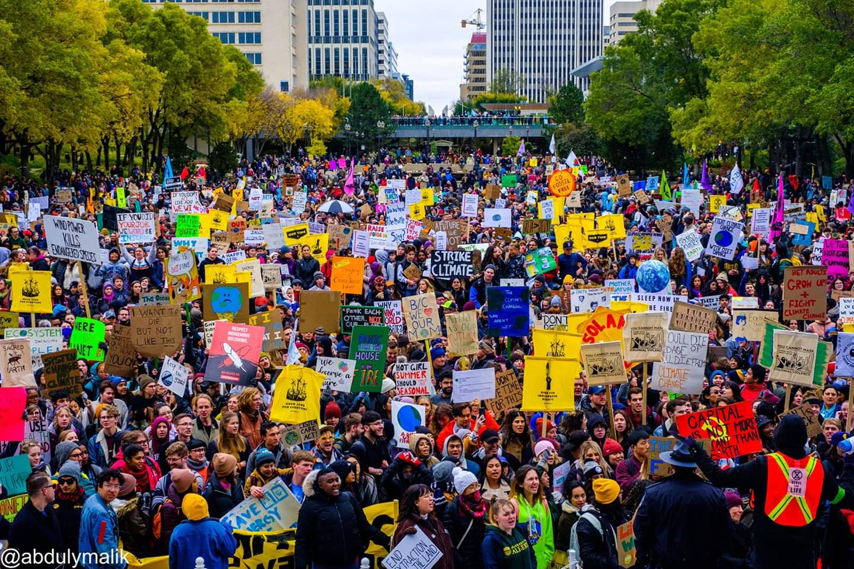
Why should AUPE support a Just Transition for Alberta?
Members are already experiencing the negative impacts of climate change
Increased number of natural disasters
Climate related disasters contribute to high food prices and the current inflation crisis
Climate change negatively impacts health, housing, employment, affordability
We can create more unionized jobs by shifting away from fossil fuels
6 to 8 times more jobs in renewable energy, energy efficiency and public transit for the money we use to subsidize fossil fuels.
Edmonton, October 18, 2019
Notes:
Why should AUPE get involved?
●Members are already experiencing the negative impacts of climate change, From Health and safety issue, to those that have lost the lives fighting natural disasters made worse by climate change.
■Alberta has already experienced some of the most expensive and damaging natural disasters in Canadian history - most of which have occurred in the last 10 years.
■Health care workers are increasingly responding to health issues that are the result of increased temperatures, poorer air quality and environmental disasters.
■Other AUPE members work with those who have been displaced or lost their livelihood because of natural disasters, or have been affected by these disasters themselves.
●We can create more unionized jobs by shifting away from fossil fuels
○After fossil fuel infrastructure is built, it doesn’t take many employees to keep producing oil and gas. Studies show that we could create 6 to 8 times more jobs by making the same investments in renewable energy, energy efficiency and public transit as we spend to subsidize producing fossil fuels
○Moreover, by shifting our focus to creating low or no carbon jobs, we are able to focus on creating new jobs in the healthcare, education and seniors care sectors, all of which are critically needed, now and in the future.
________________________
Note: “6 to 8 times” comes from a report by Blue Green Canada an alliance between Canadian labour unions, environmental and civil society organizations to advocate for working people and the environment by promoting solutions to environmental issues that have positive employment and economic impacts. https://bluegreencanada.ca/

Slide 10
How do we make it happen?
Call on provincial and federal governments to make long-term commitments to support a Just Transition that leaves no workers behind
Not corporate welfare for fossil fuel companies
What should the union do as an organization to implement principles of a Just Transition?
Facilitating conversations with workers about what the future could look like
Advocating for public green jobs programs
Building solidarity with other unions
Notes:
-Unions have long been at the forefront of organizing for workers in a way that has benefited society as a whole.
-Better working conditions
-Better Social programs
and fighting against privatization
-Unions can and have led the way to make the lives of working people better by advocating for a Green New Deal [or a Just Transition] and supporting the work of organizers fighting against climate change.
-We call on provincial and federal governments to make long-term commitments to support a Green New Deal
-Frankly every political party needs to do much better to support polices that create a real Just Transition that empowers workers to decide their own futures. Many of the plans that have been announced are just new ways to give fossil fuel corporations public money to dump into projects that allow them to “offset” their emissions (e.g. carbon capture and storage) while doing nothing to plan for the futures of their employees.
-With this presentation, we want to start having conversations with our members about what they think AUPE should do as an organization to implement principles of a Just Transition [or a Green New Deal]. These are just the ideas of our committee, but we are interested in hearing more.

Slide 11
Questions and Feedback
Notes:
Thank you very much for giving us the opportunity to talk with you about what a Just Transition [Green New Deal] could look like in Alberta. Now we would be happy to take your questions and hear your ideas.

